Slide 1
STATE DIRECTOR OF EVANGELIZATION & FAITH FORMATION
Chris Wegener

Slide 2
Cor
What?
A gathering or meeting with a flexible structure of Prayer, Formation, and Fraternity.
This doesn’t have to be NEW!
Notes:
For those of you who may be seeing this for the first time; it will be good to explain the basic framework.

Slide 3
Cor
When?
Consistently.
Cor can be weekly, bi-weekly, or monthly.
Cor gatherings normally last between 60-90 minutes
Notes:
For those of you who may be seeing this for the first time; it will be good to explain the basic framework.

Slide 4
Cor
How?
With Pastoral approval
With resources available on KofC.org, FORMED, or in collaboration with your Pastor
Notes:
For those of you who may be seeing this for the first time; it will be good to explain the basic framework.

Slide 5
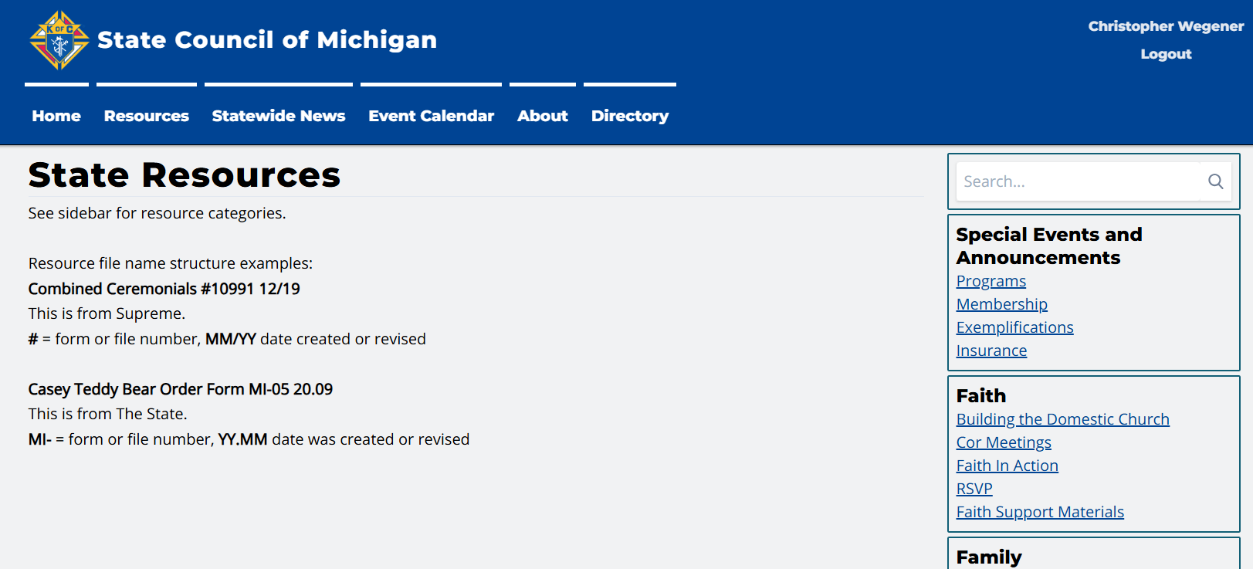
Cor
Notes:
For those of you who may be seeing this for the first time; it will be good to explain the basic framework.

Slide 6
Cor
Who?
Council EFF Director
Brother Knights
Men of the Parish & community
Notes:
For those of you who may be seeing this for the first time; it will be good to explain the basic framework.

Slide 7
Cor
Why?
Because families need strong husbands and fathers, and the world needs courageous witnesses to Jesus Christ.
Because who we chose to surround ourselves with impacts our lives
Because Faith Formation is ongoing
Notes:
For those of you who may be seeing this for the first time; it will be good to explain the basic framework.

Slide 8
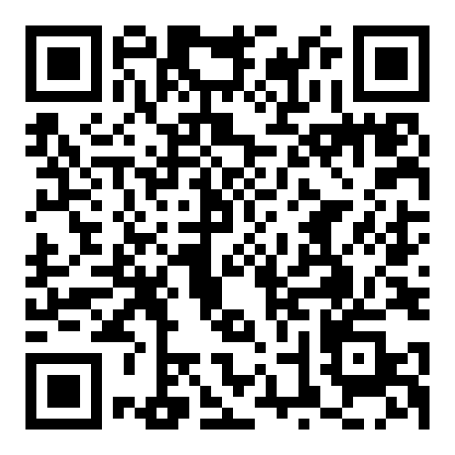
2025-26 Goals
Council EFF Directors
75% of Councils by September 30th
90% of Councils by December 31st
^{st}
90% of Councils by March 31st
Notes:
For those of you who may be seeing this for the first time; it will be good to explain the basic framework.

Slide 9
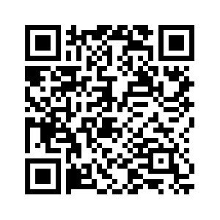
2025-26 Goals
Cor Meetings - Conducted & Tracked
75% of Councils by December 31st
90% of Councils by March 31st
Notes:
For those of you who may be seeing this for the first time; it will be good to explain the basic framework.

